Slide 1


Slide 2
Two Disadvantages of Anonymous Communication
Koray can yurtseven
Sectıon 47
2099547
Ceng

Slide 3
Overview
Promotes Bad Behaviour
Internet trolls

Slide 4

Promotes Bad Behaviour
Racism, bullying
Abusive tendencies
Bad grammar
‘’Wtf stupidd ppl ahahahhaha wtf wrong with the ppl,with ppl these days’’
-keshaladygagabritney

Slide 5
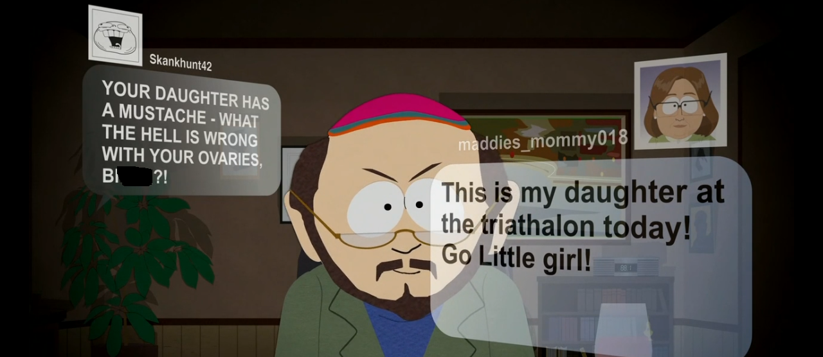
Internet trolls

Slide 6
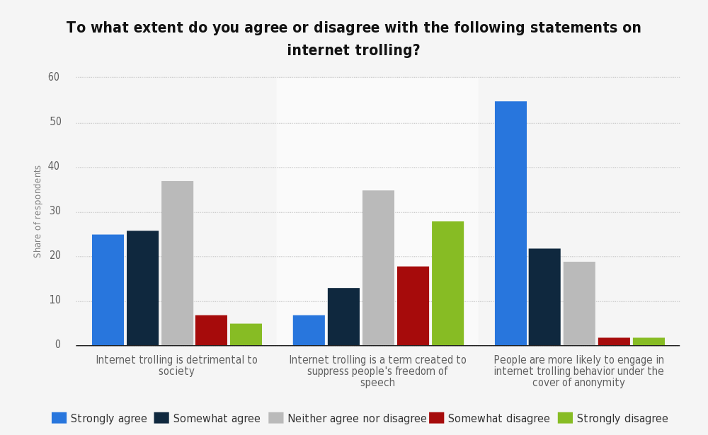
Internet trolls
Retrieved from Statista.com

Slide 7
Conclusion
Talk freely and hurt others
Trolling other people

Slide 8
Thank You

Slide 9
References
Klempka, A., Stimson, A. (n.d.). Anonymous Communication on the Internet and Trolling. Retrieved from http://www.indiana.edu/~tisj/readers/full-text/15-2%20kling.pdf
Yougov.com. (n.d.). To what extent do you agree or disagree with the following statements on internet trolling?. In Statista - The Statistics Portal. Retrieved January 2, 2017, from https://www.statista.com/statistics/380047/agree-disagree-internet- trolling/.

